Slide 1
CEMEX Go – Open Platform
October 10th, 2019
PROCORE Integration

Slide 2
Get the CEMEX Go Embedded App
CEMEX Go - Open Platform
PROCORE

Slide 3
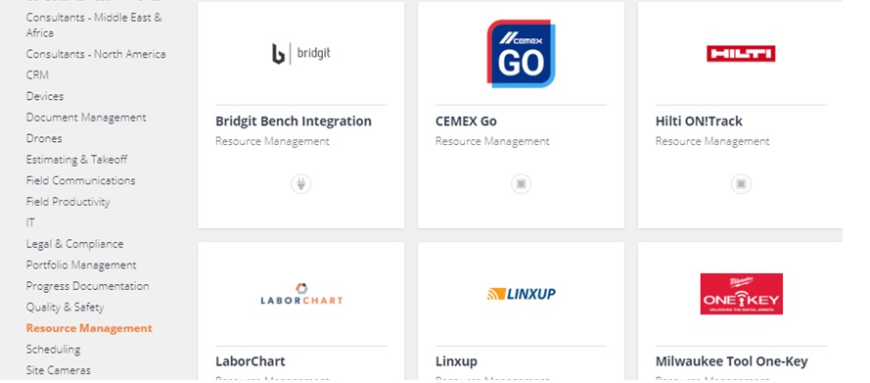
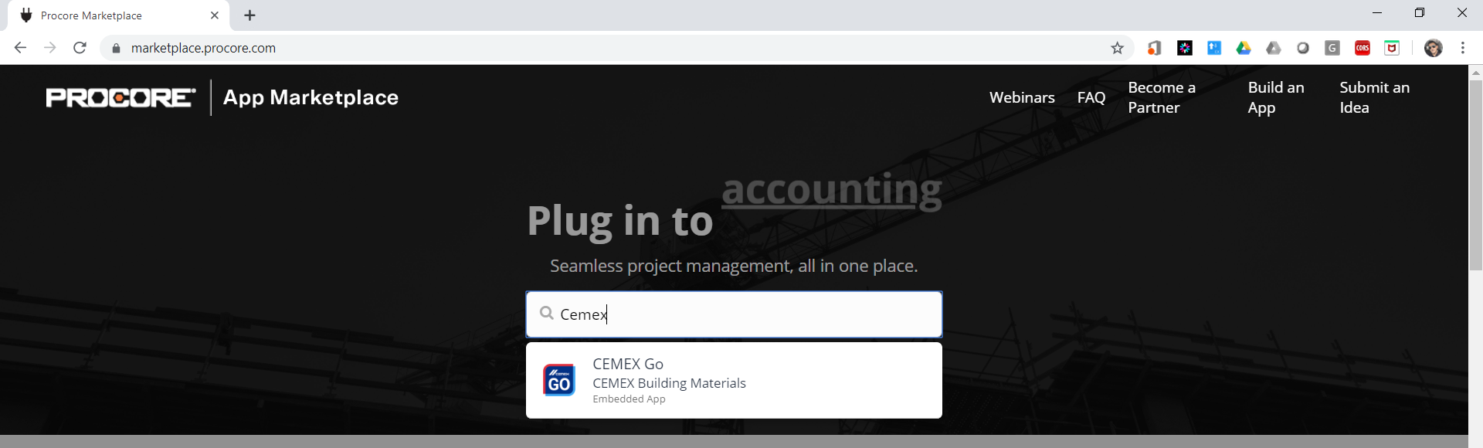
App Marketplace PROCORE
Go to the PROCORE App Marketplace.
User can go and type “CEMEX” in the search box and it will be automatically prompt to the nearest options.
User can go and look by categories under “Resource Management”.

Slide 4
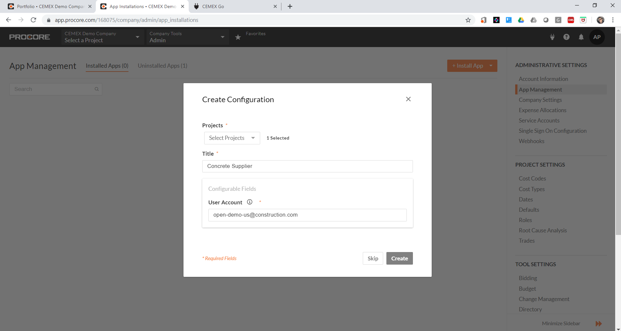
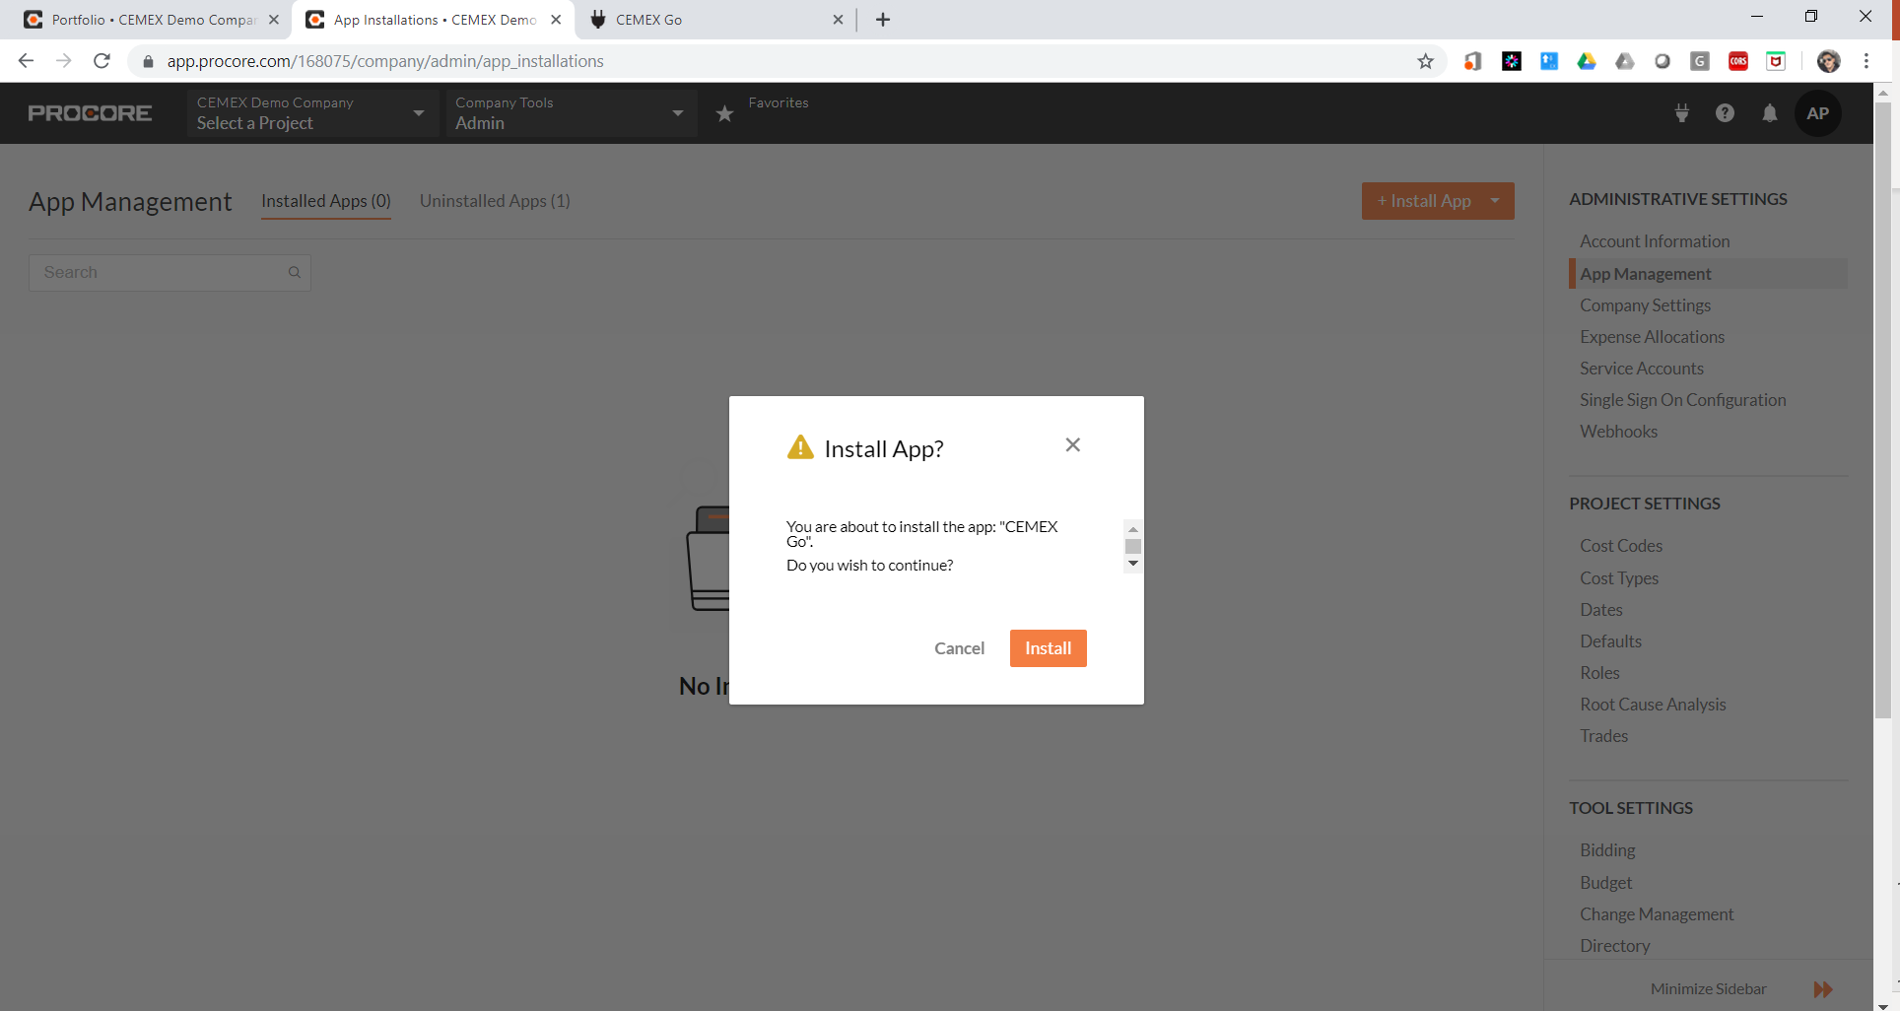
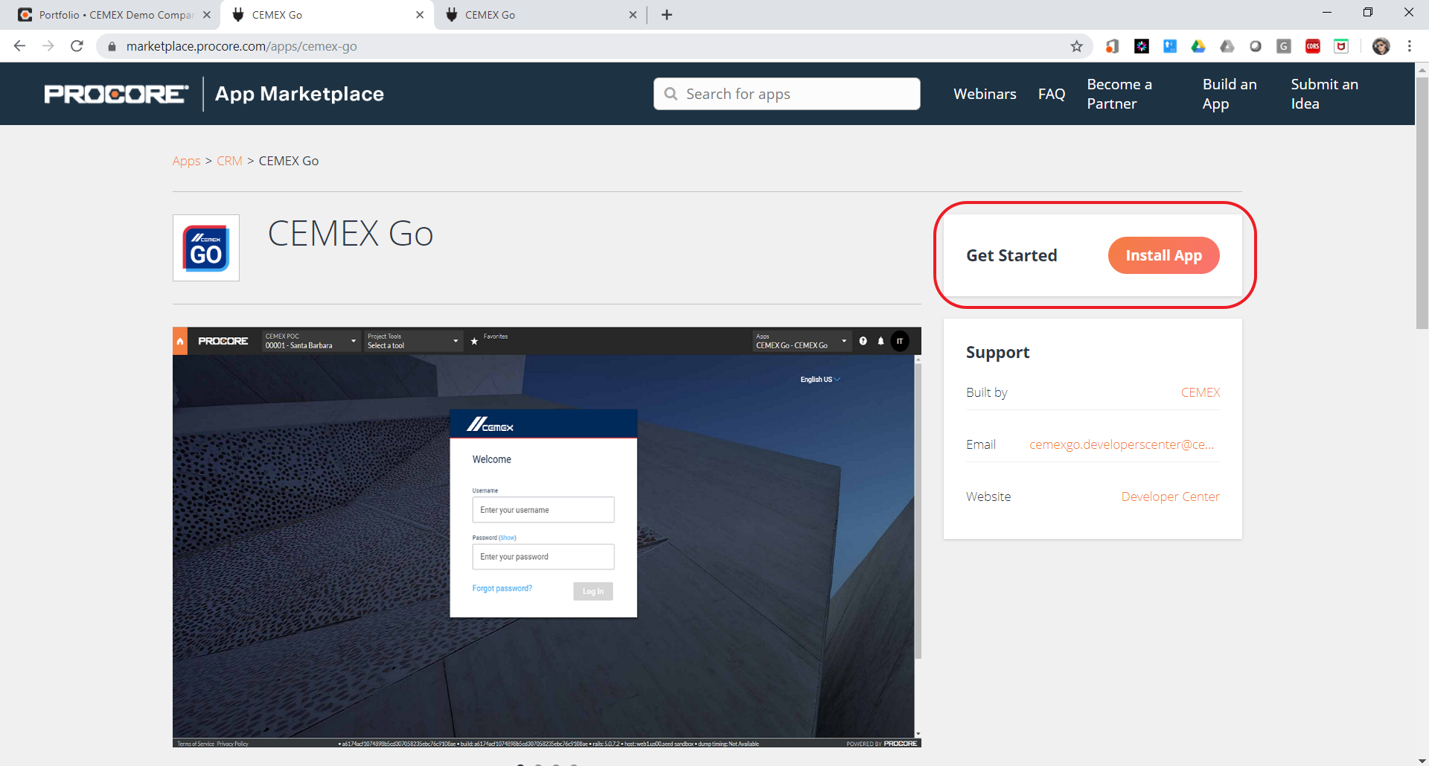
Installing the App PROCORE
Click on “Install App” and confirm the installation.
Select the projects you want the app to be available in.
Setup a name/alias/title you like to identify the app installation.
Setup the CEMEX Go user account that will be used to connect.

Slide 5
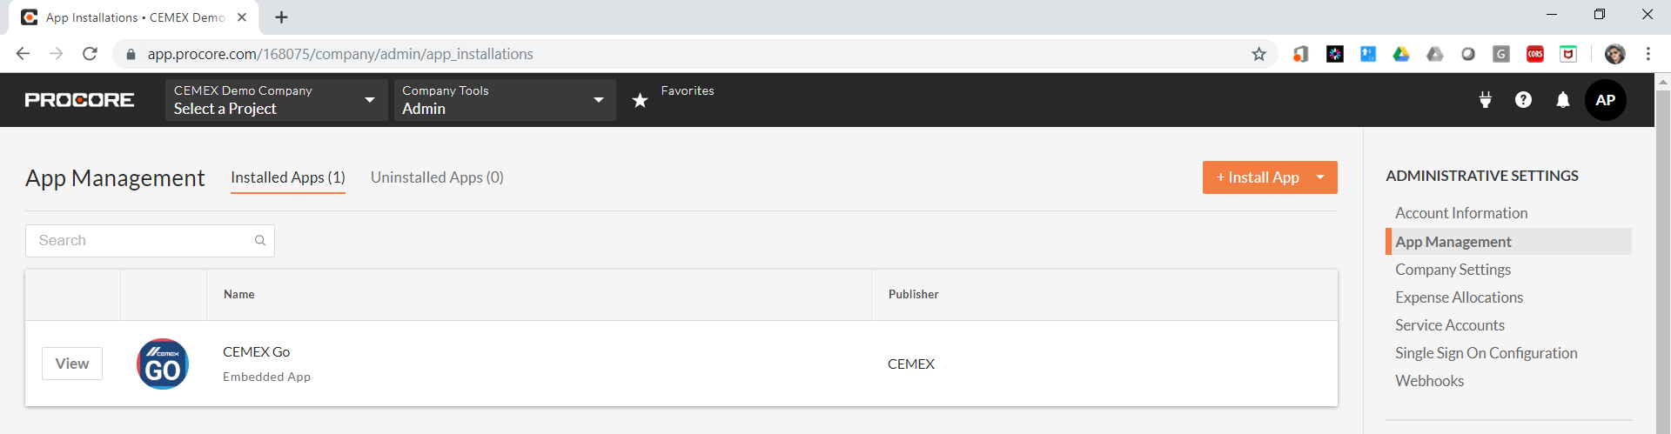
CEMEX Go Embedded App Features PROCORE
Once the app gets installed, the users have the following benefits:
Map PROCORE Companies to CEMEX Customers
Map PROCORE Projects to CEMEX Jobsites
Receive Deliveries Updates in the Daily Logs for mapped PROCORE Projects
Use all CEMEX Go Features from the same page inside PROCORE site

Slide 6
Working Together
CEMEX Go - Open Platform
PROCORE

Slide 7
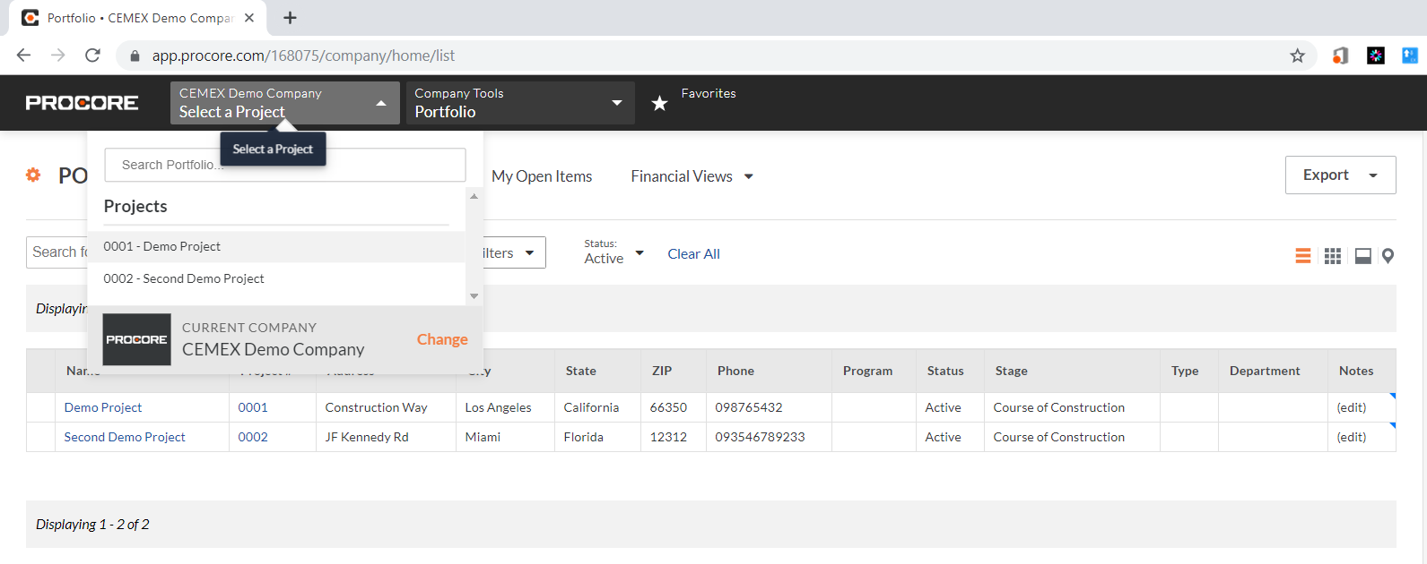
Using CEMEX Go Embedded App PROCORE
To start using CEMEX Go, the user needs to select a project which he wants to work with and that also has the CEMEX Go App available to be used.

Slide 8
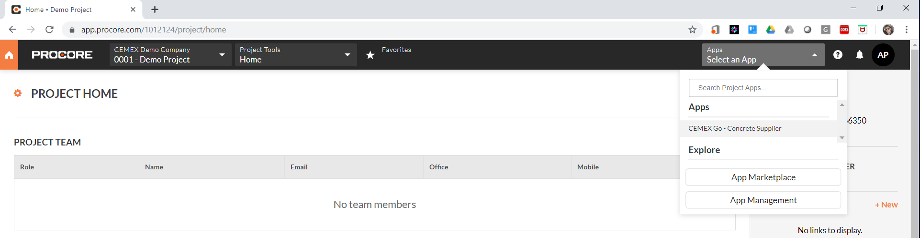
Using CEMEX Go Embedded App PROCORE
Once the user selected a project, if the project has available apps installed/configured for it, there would be a new menu at the top right side of the window, where the user can see the apps the project has available.
In this case, CEMEX Go – Concrete Supplier is shown.

Slide 9
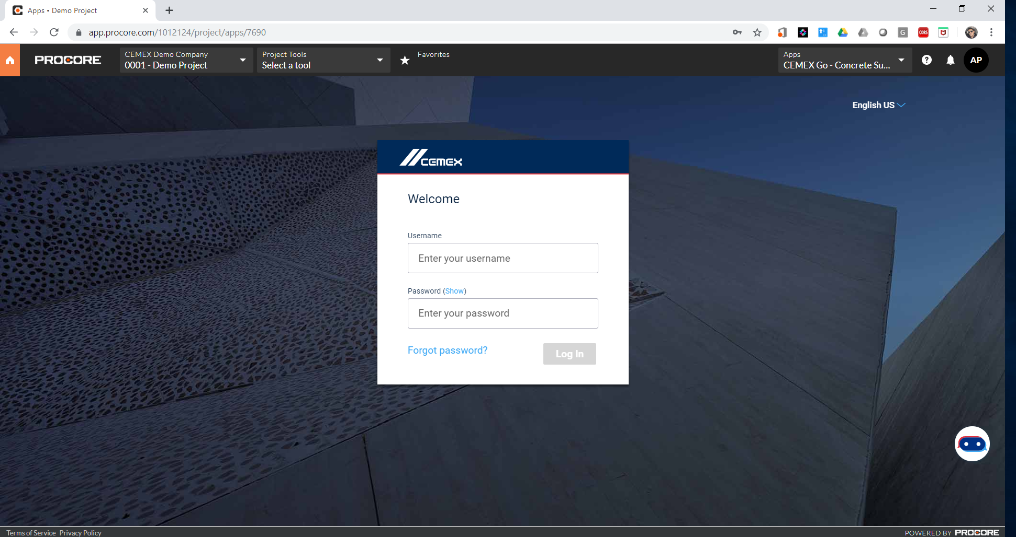
Using CEMEX Go Embedded App PROCORE
When the user chooses the CEMEX Go app from the menu, automatically CEMEX Go is being opened inside PROCORE Platform.
At this moment, login page is shown so the user can enter its own CEMEX Go credentials.
Note: its important to allow popups since its needed in order to fetch authorization code to grant CEMEX Go to connect to PROCORE.

Slide 10
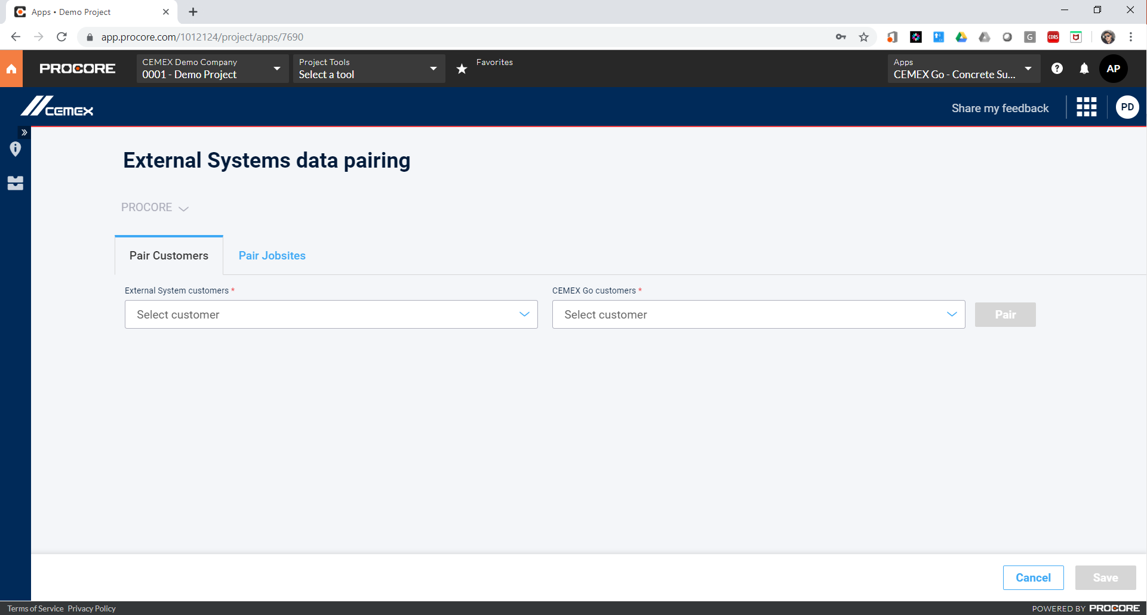
Using CEMEX Go Embedded App PROCORE
Once the user logs in, CEMEX Go opens by default the “Data Exchange” module.
This module is the most important in order to interoperate both platforms, so the user has to pair/match their information from both systems, as much info as he wants to keep in sync and make the systems work together.
At this moment, the user is able to pair CEMEX Customers with PROCORE Companies, and CEMEX Jobsites with PROCORE Projects.

Slide 11
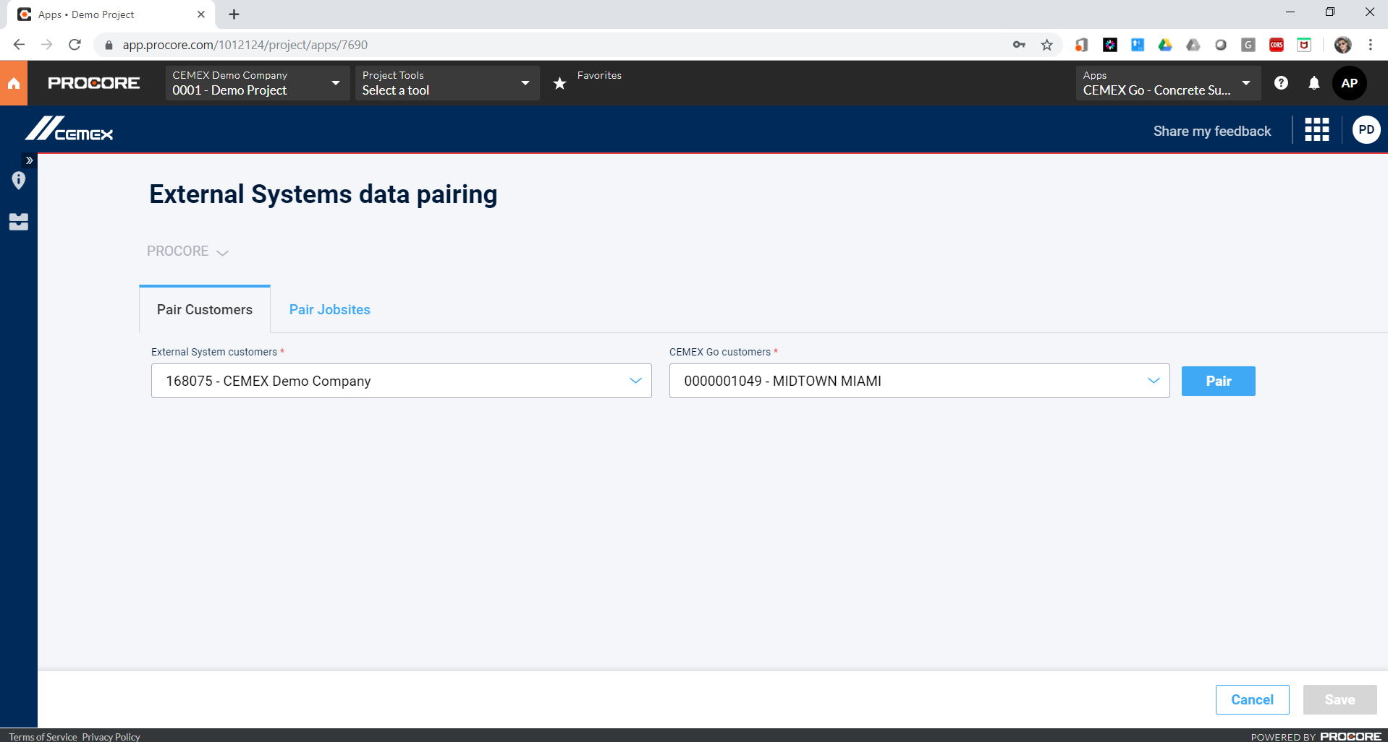
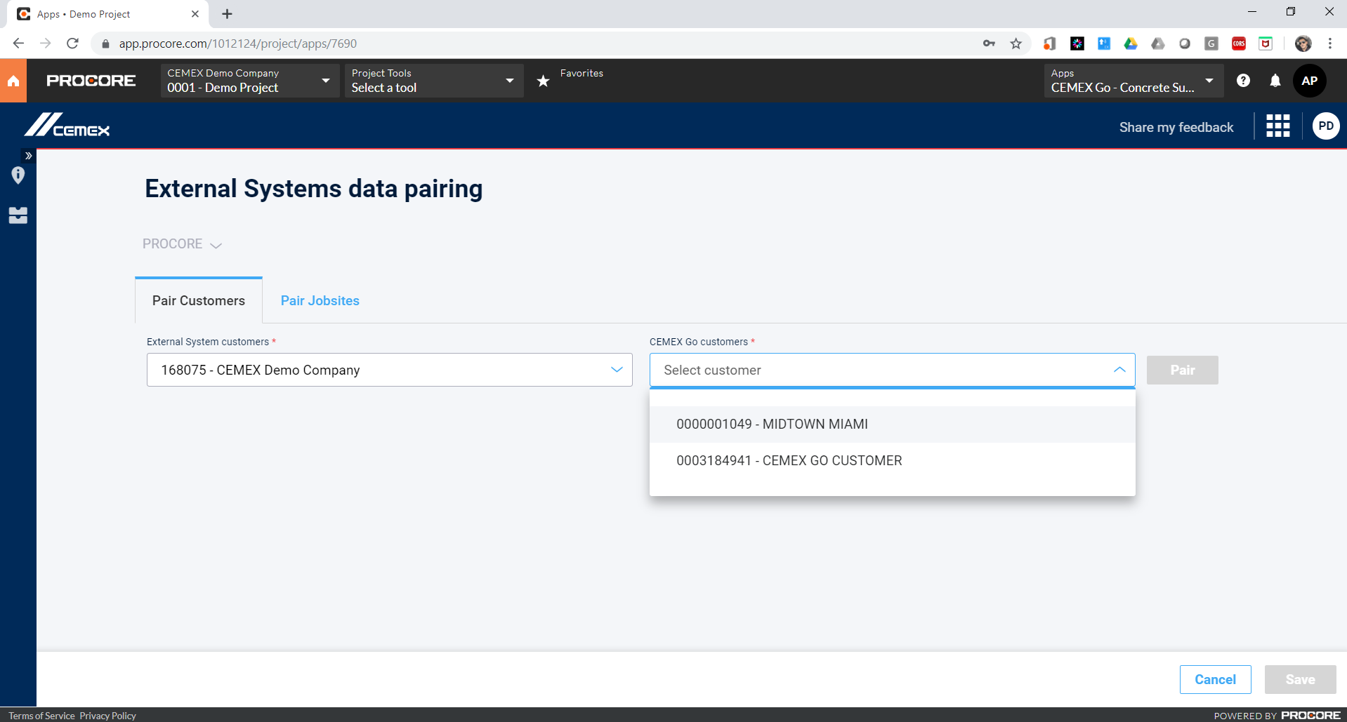
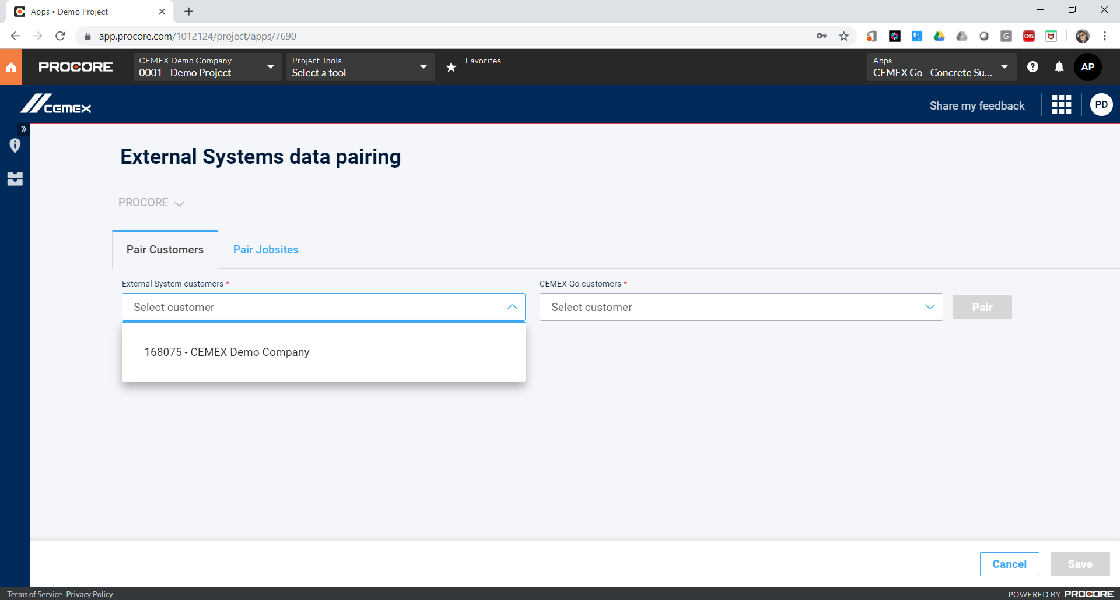
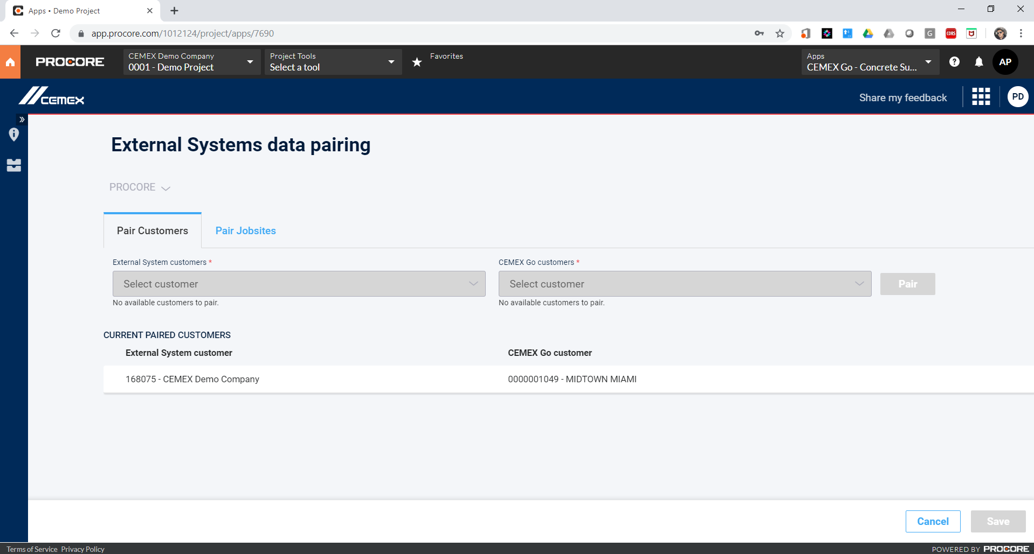
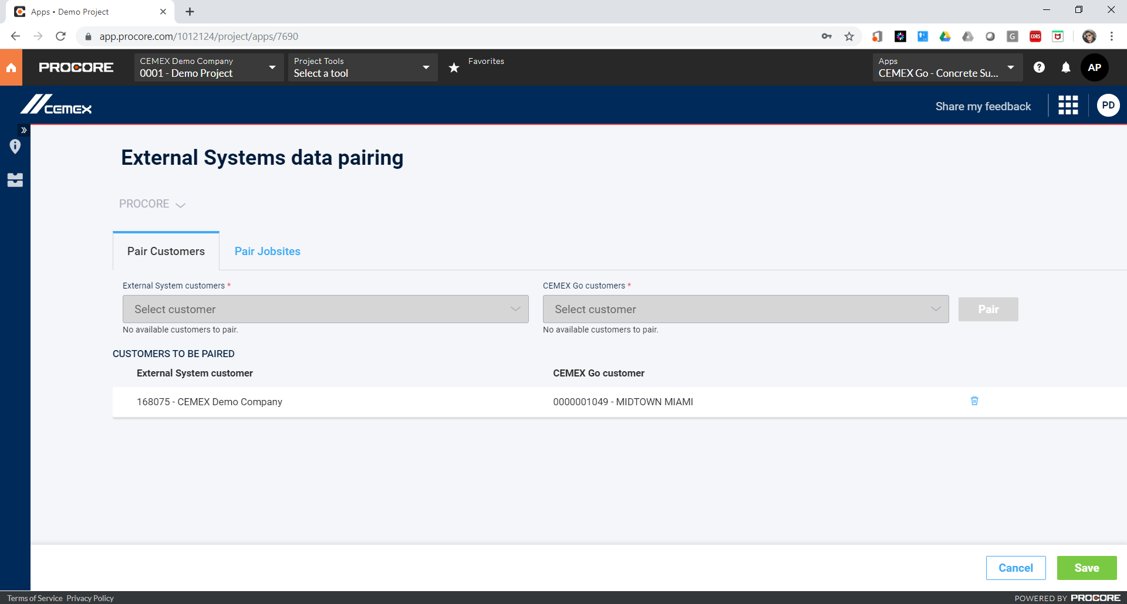
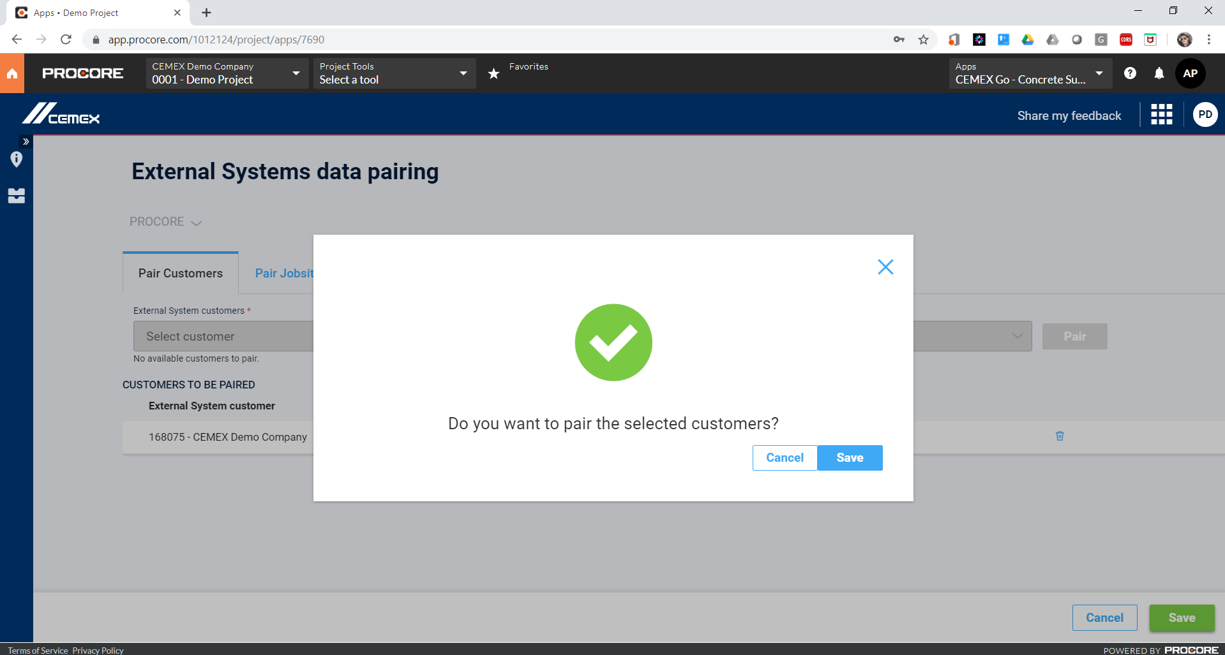
Mapping Companies to Customers PROCORE
In this screen the user can choose a Company from PROCORE or any other enabled external system and a CEMEX customer from their corresponding lists, then he just click on “Pair”.
The user can see in the middle table the list of companies-customers he is being paired, also, he can choose to undo some of the pairs.
In case there would be data already paired, the data would be shown listed in the bottom side.
The whole transaction will not be accomplished until he clicks on Save button and confirm the transaction.

Slide 12
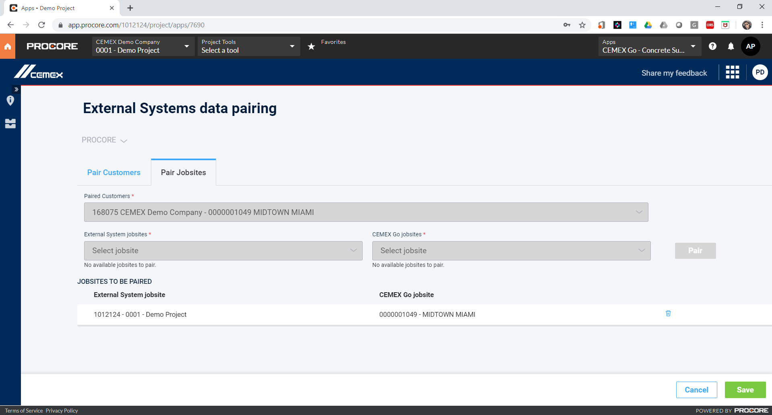
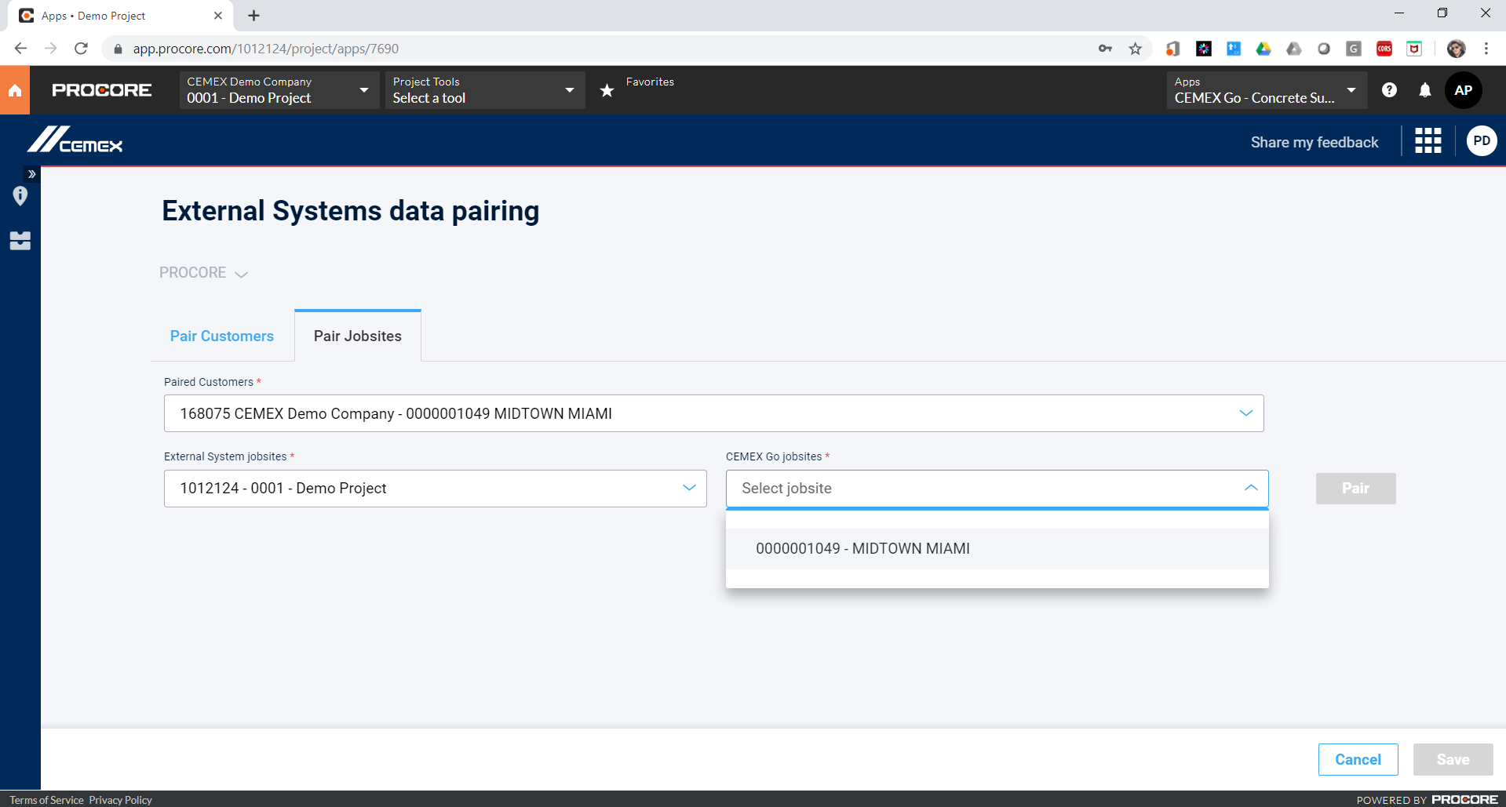
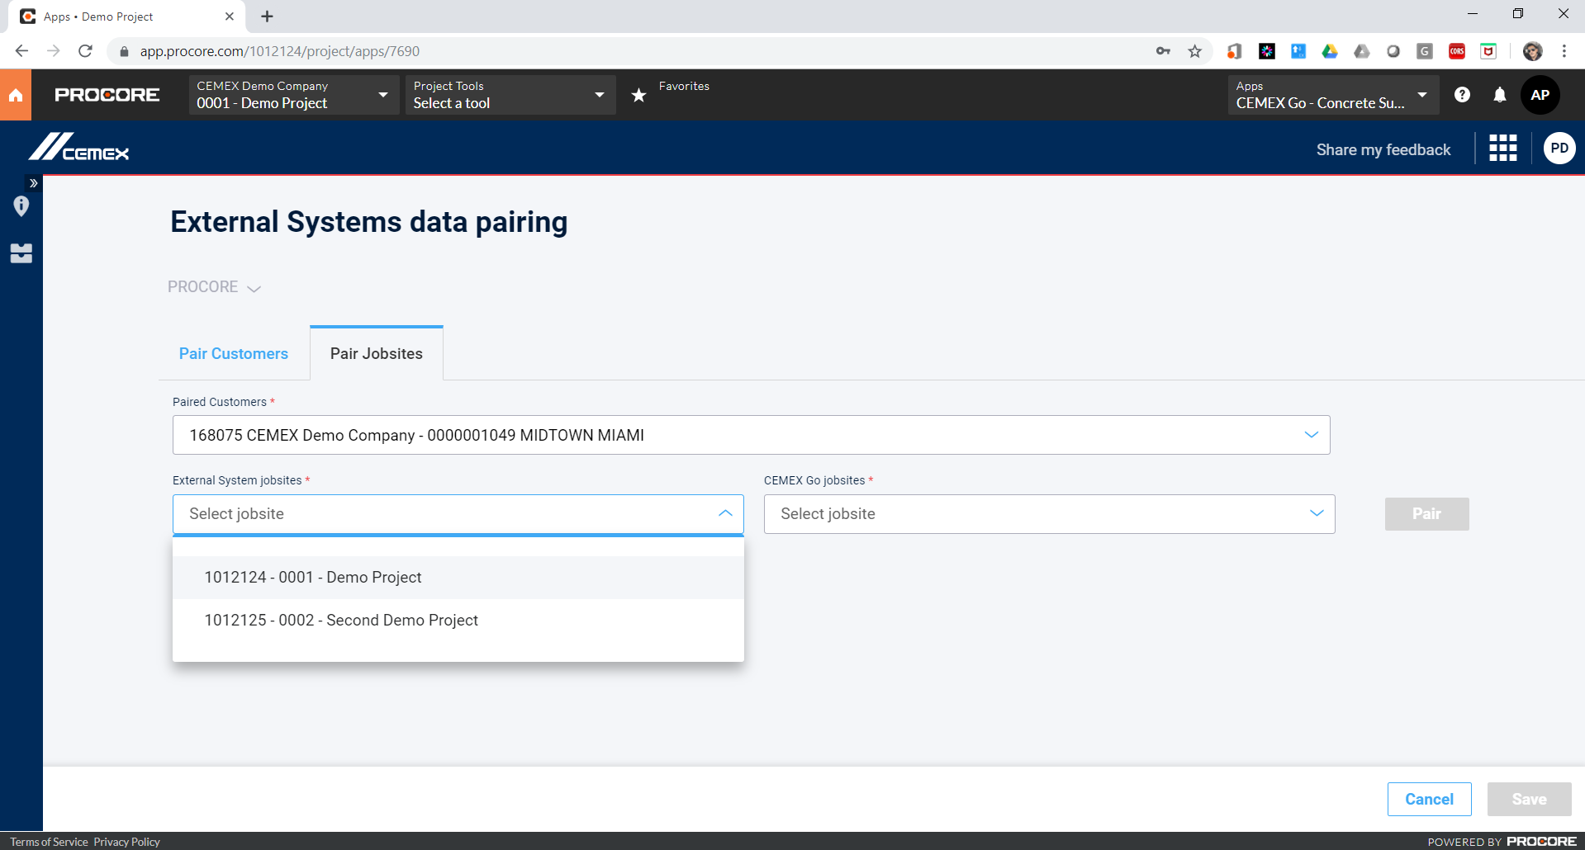
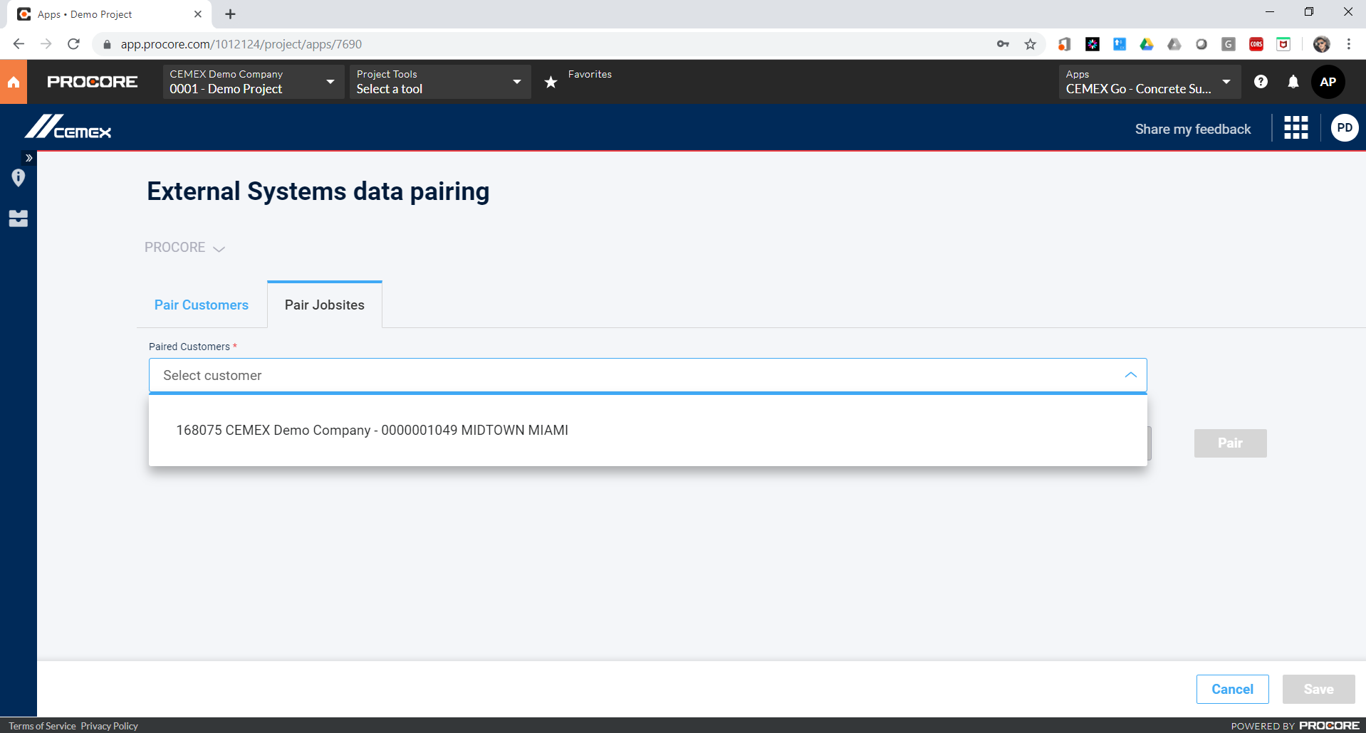
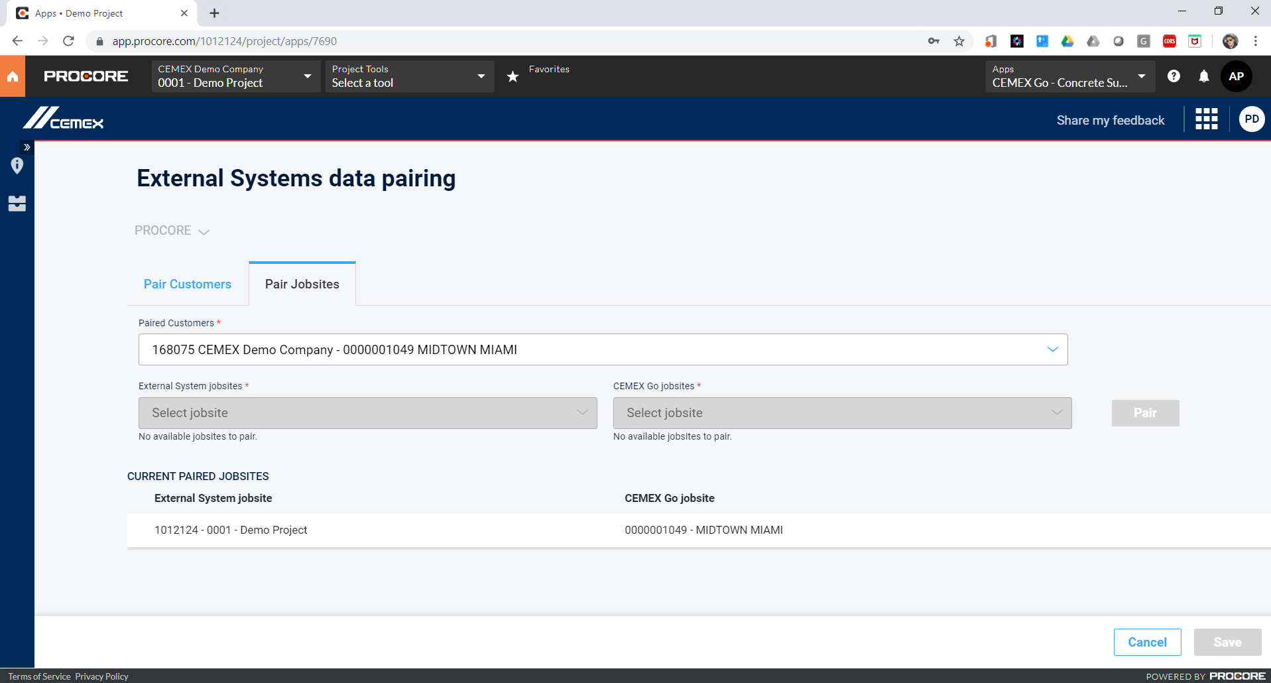
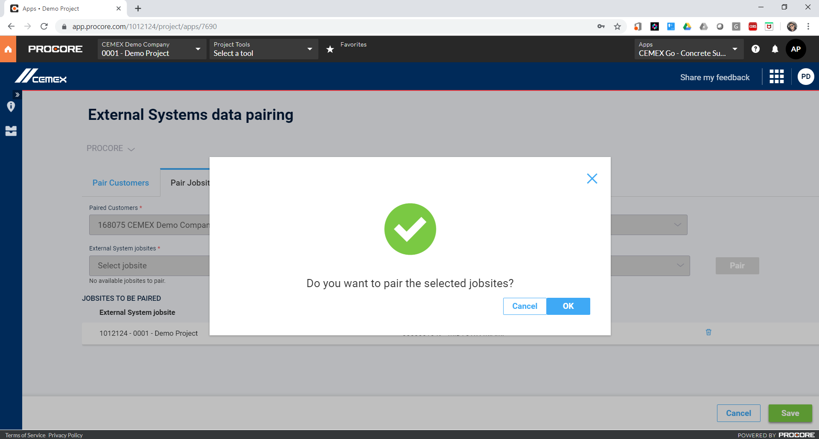
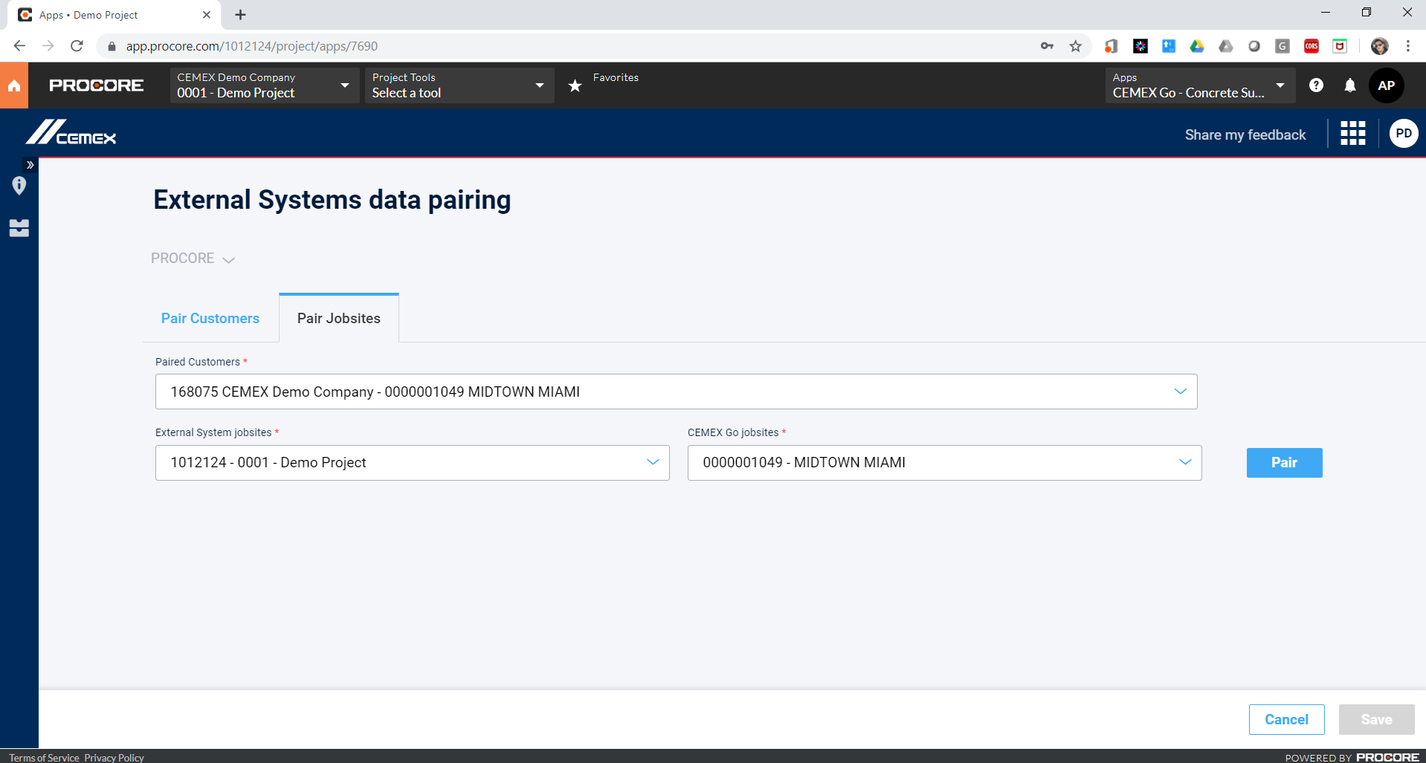
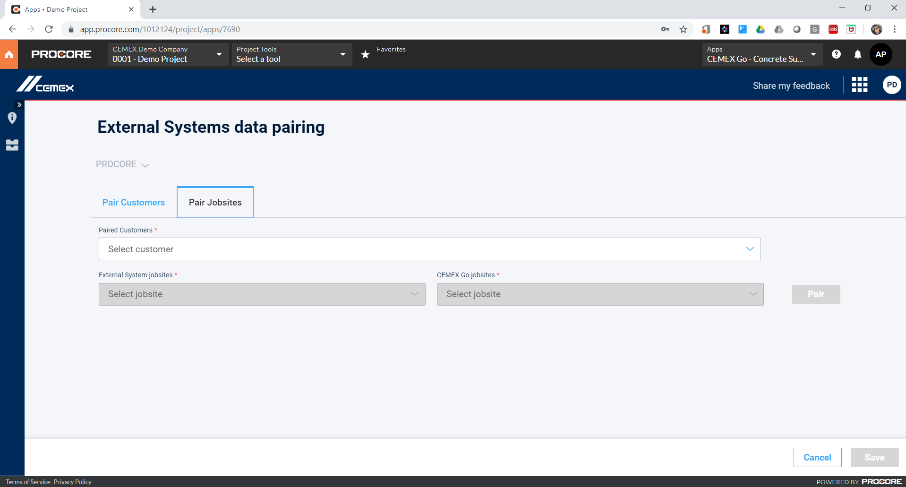
Mapping Projects to Jobsites PROCORE
Once the user already pair/map their customer data. He can choose to map the projects with the jobsites.
A previous similar screen is shown so the user can select for each paired customer, the projects and jobsites related to it in order to pair them.
On going data will appear in the middle table. And the user also has the option to undo the pairs.
In the table below, the user can see the jobsites already paired for the selected company/customer.

Slide 13
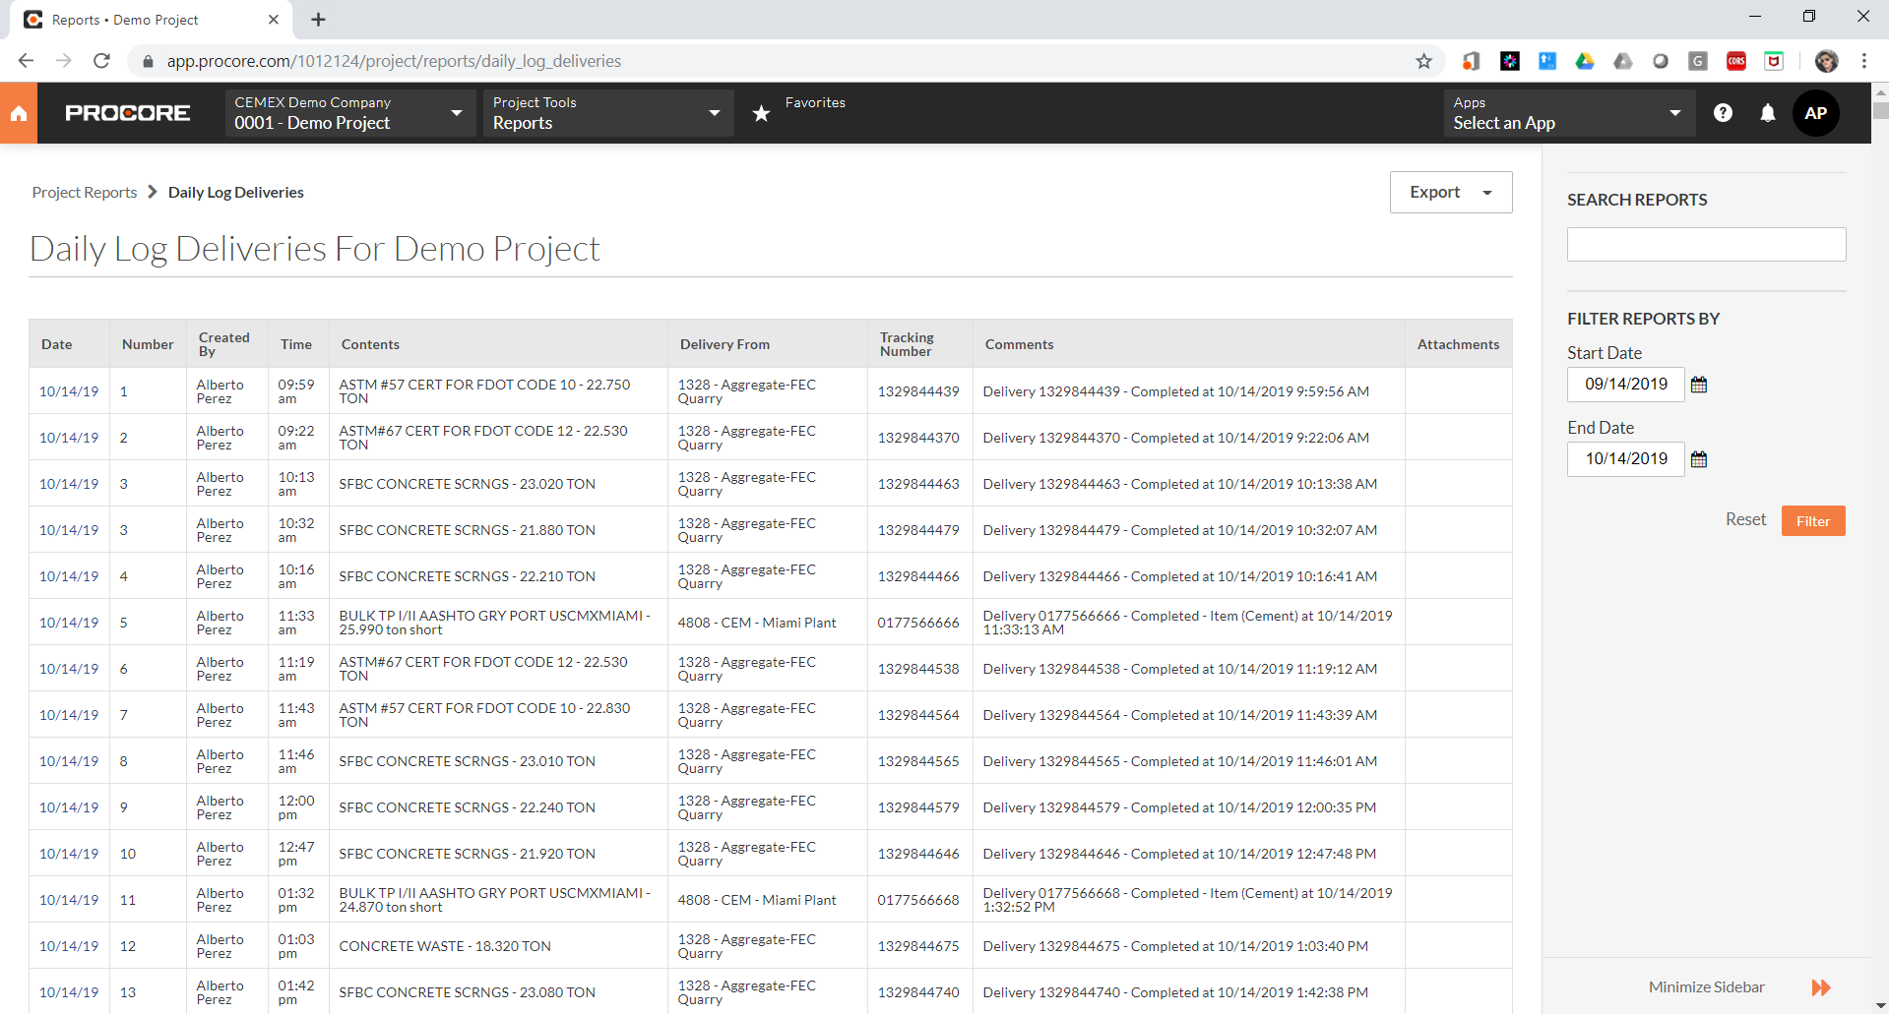
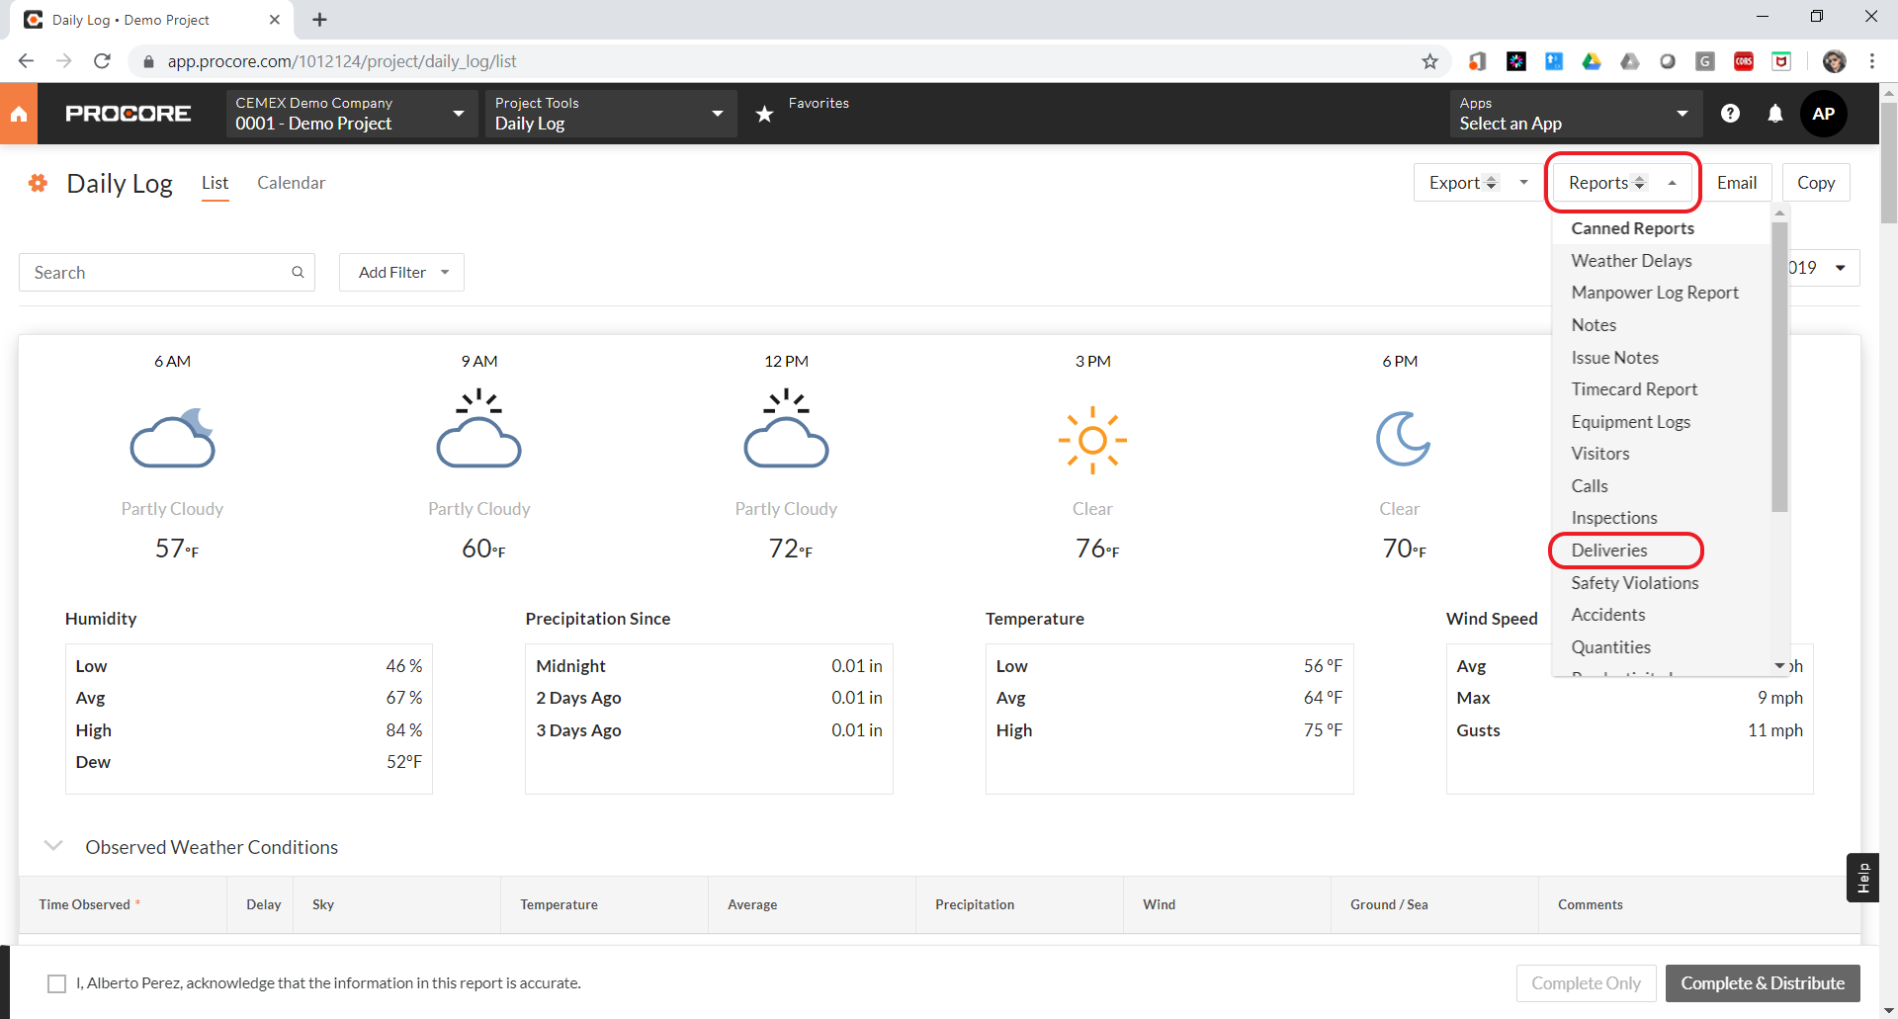
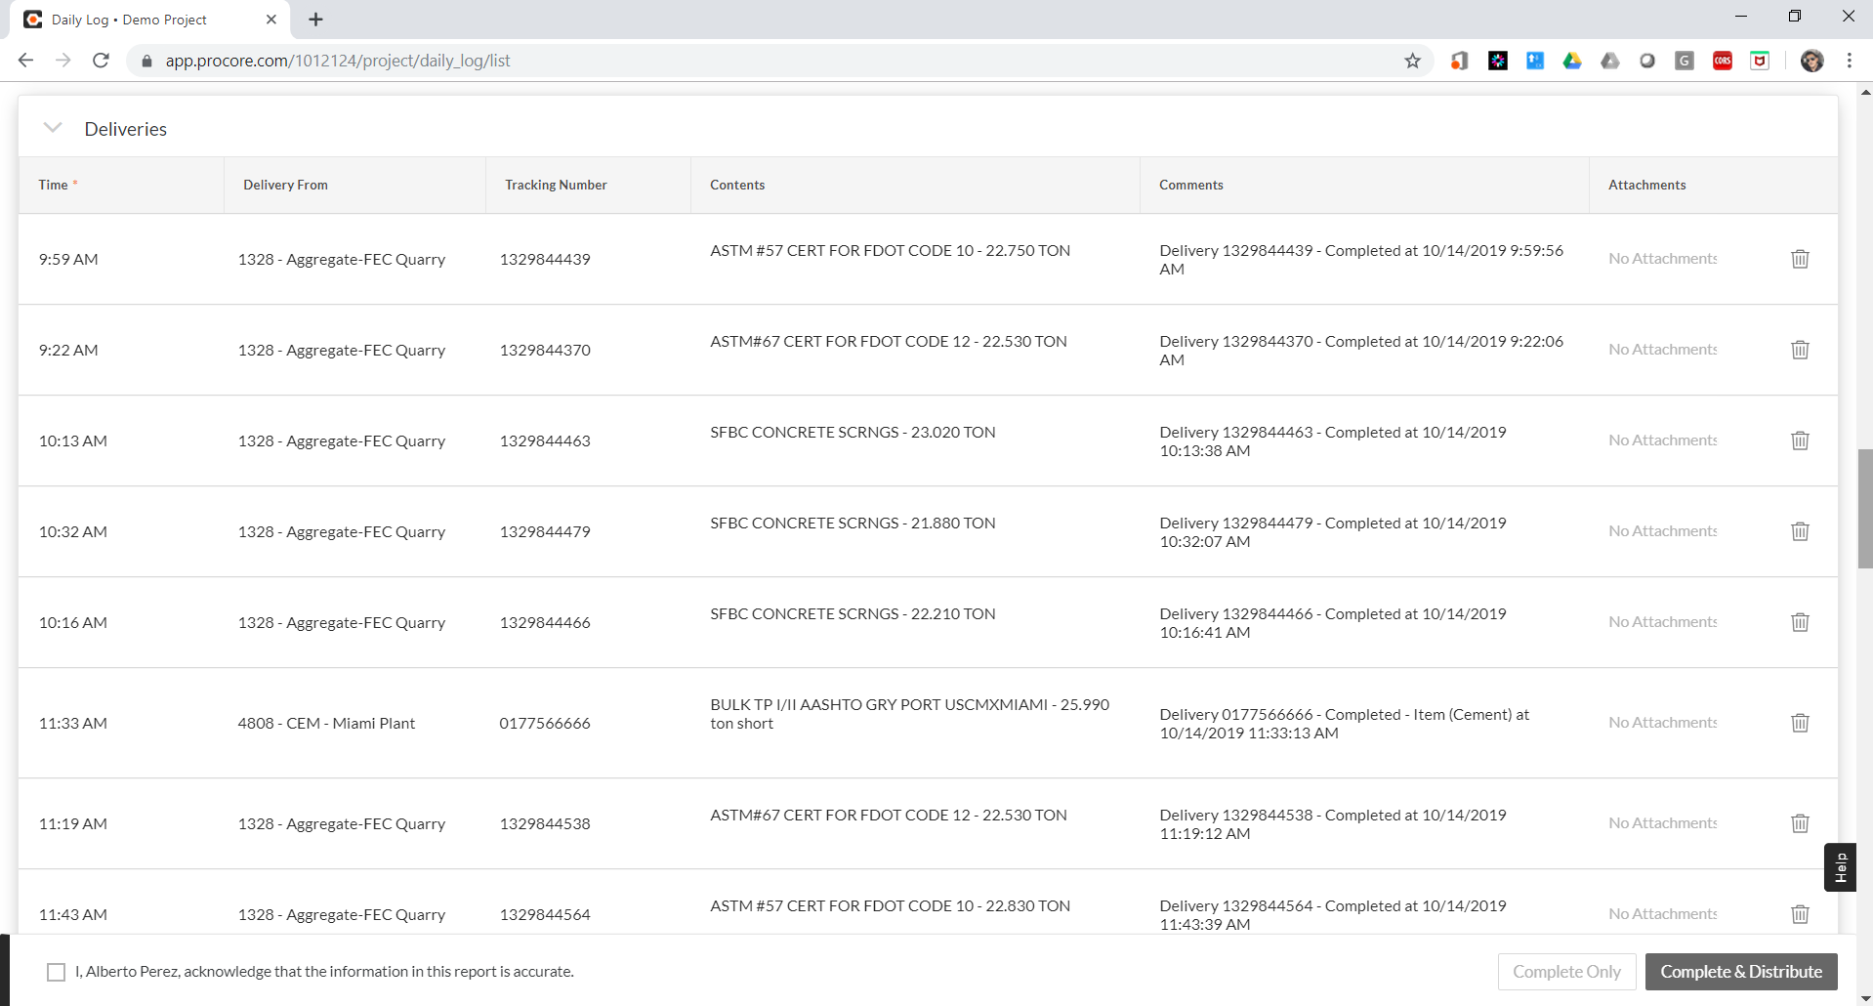
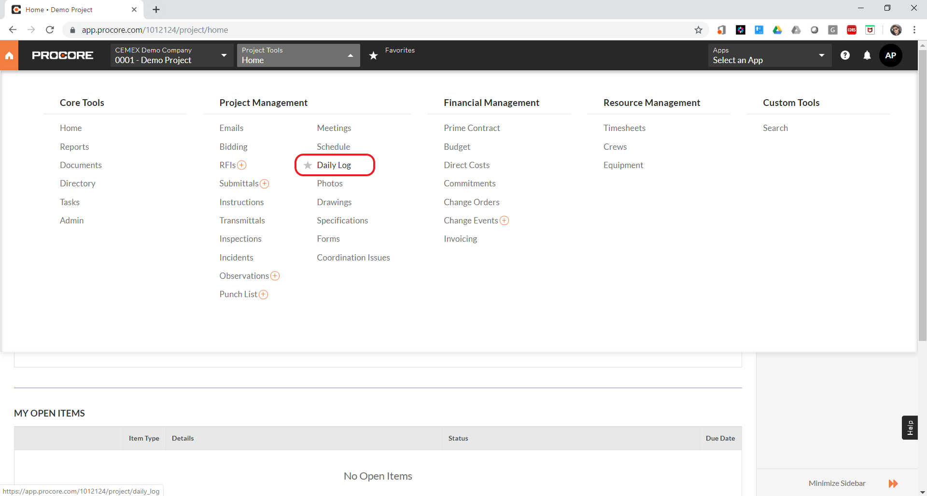
Receiving Deliveries Updates in the Daily Logs PROCORE
Once the user has customer and jobsites paired, CEMEX Go backend system will connect to PROCORE to send deliveries statuses changes to the PROCORE Delivery Log for each paired project.
The user will be able to see a delivery change log coming from CEMEX inside each paired project inside the PROCORE Delivery Daily Log and also from Project reports.

Slide 14
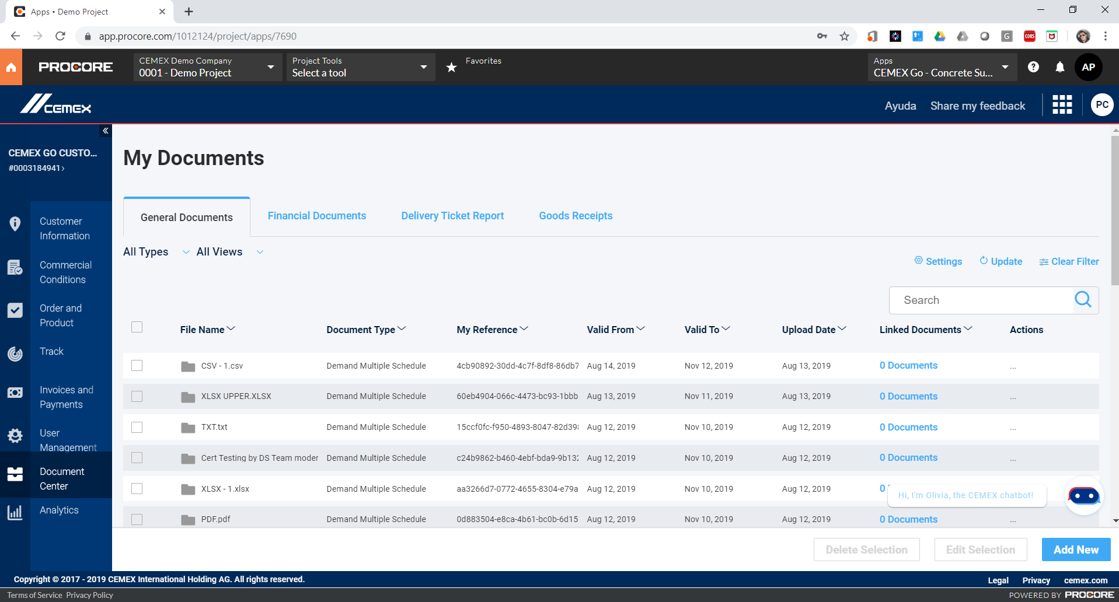
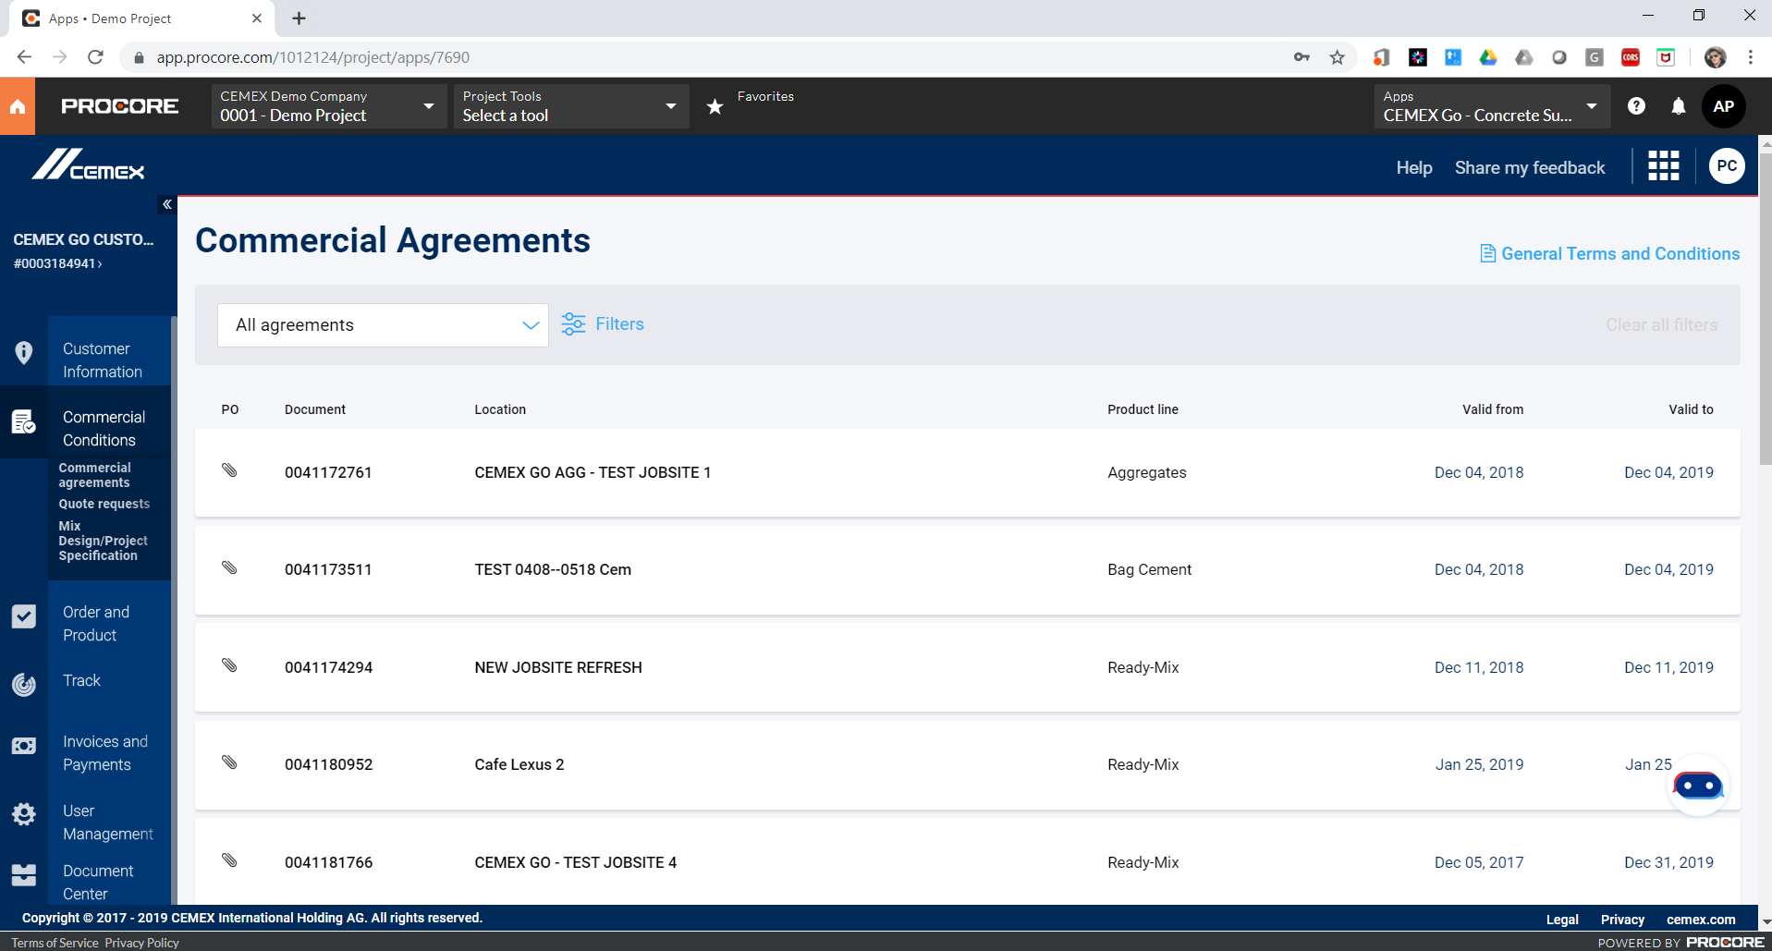
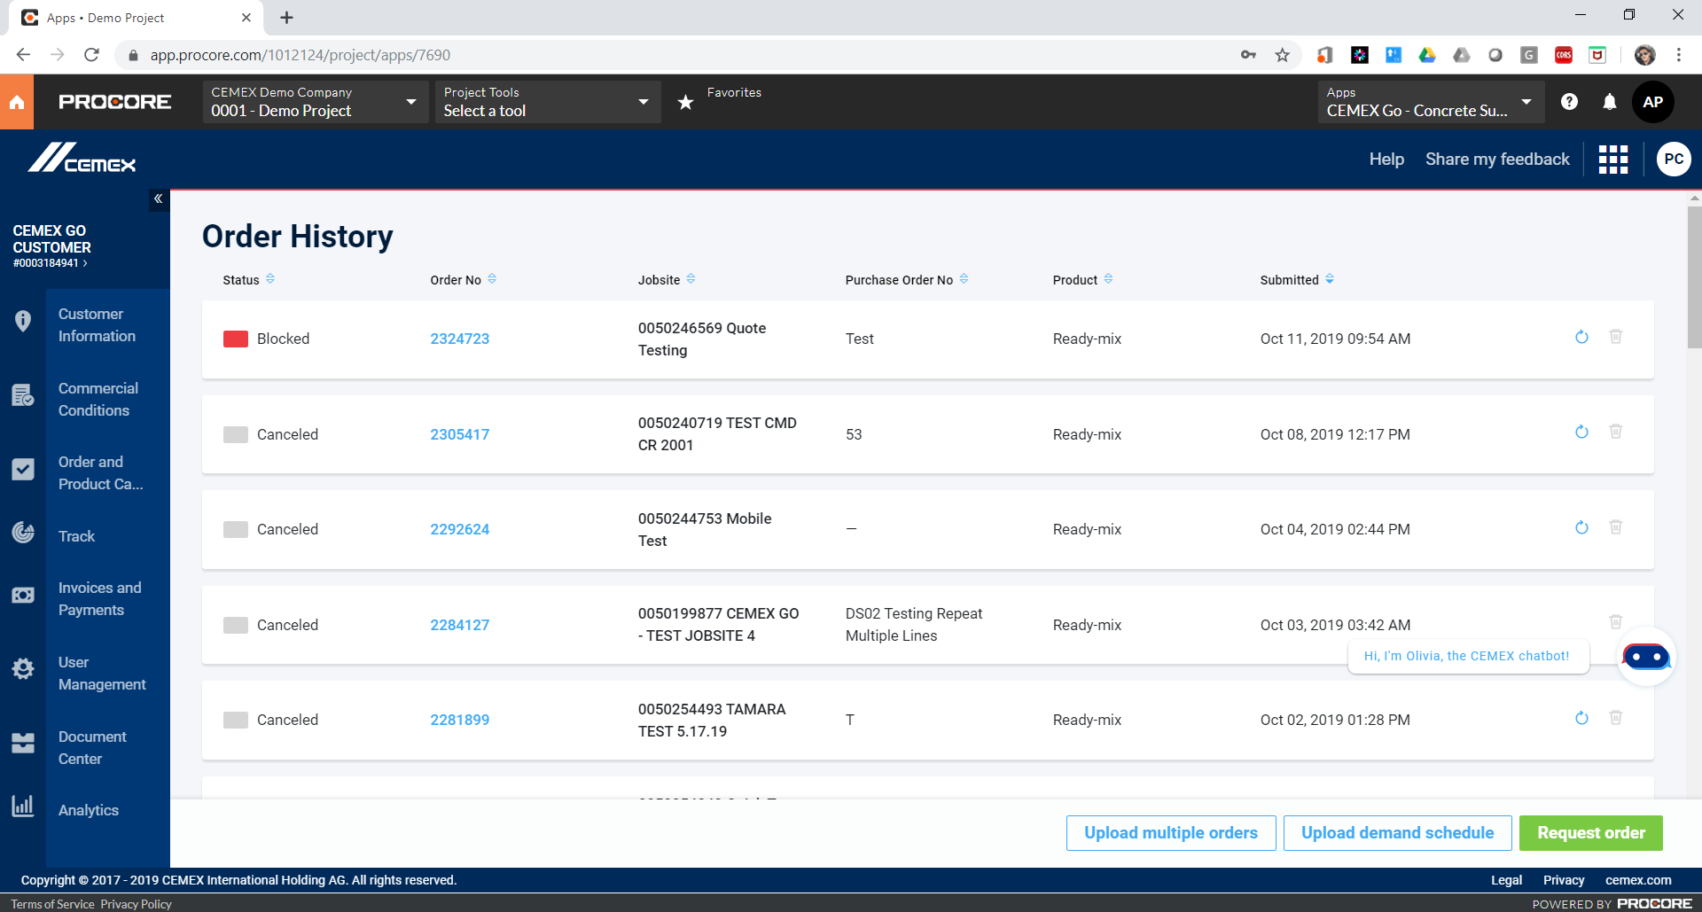
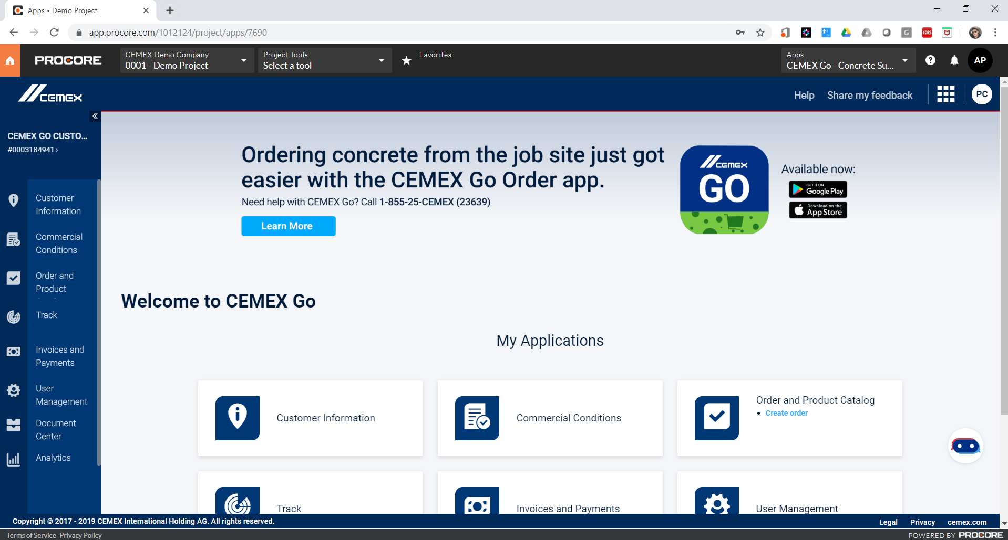
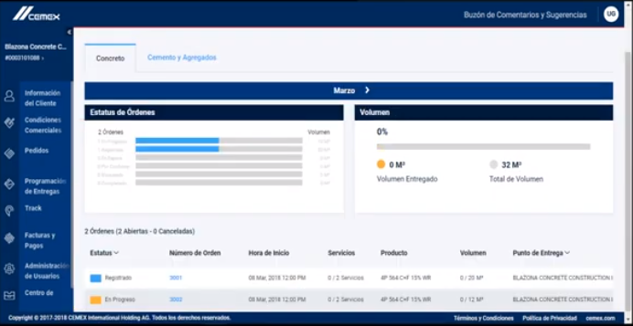
Take CEMEX Go Embedded App Beyond PROCORE
Besides the Data Exchange Module, the user can do whatever else the CEMEX Go Account allow him to do regularly.
He can navigate and use CEMEX Go as usual from the same window.

Slide 15
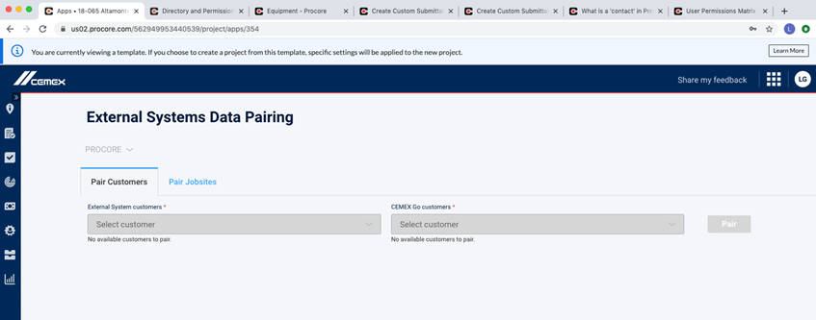
Having issues?
If you experience a troubleshooting in the pairing process, please delete the cache and cookies from your browser, if you continue experiencing issues send an email to: cemexgo.developerscenter@cemex.com

